Slide 1


FlexJob
Submitted To:
Devang Patel Institute of Advance Technology and Research
Developed By :
Jay Pandya (19dcs074)
Mayank Jadav(19dcs040)
Vivek Mangrola (19dcs057)
Guided By:
Prof. Priyal Vaghela
Prof. Chandrasekar Pawar

Slide 2
Contents
Project Profile
Objective Of Project
Project Category
Environment Description
System Flowchart
Implementation Screenshots
Limitations of the Project
Project Outcomes
Future Enhancements
Conclusion
References

Slide 3
1. Project Profile
Project Title | Flex Jobs
Project category | Web Development
Front-Hand | HTML, CSS, JAVASCRIPT
Backhand | PHP

Slide 4
2. Objective of Project
The main objective for the Flex Job system for the online job seeker are:
To give the company information about the job and task.
High rating profile can get more jobs.
All users can view the all type of jobs.
The site must be easy and flexible to use Navigate must be smoother and company be able to understand the links.
To attract the company by showing your skill the extreme feature, services and hence achieve company satisfaction.

Slide 5
3. Project Category
The Flex Job project category is Web Development (website).
The project entitled “Online Job website” the main aim of project is to provide jobs and company information that provided by others. The main theme is to provide jobs.
The process of post a jobs is little because we are allowing an user to post their jobs related information and their work experience. Now you have to select the category of Jobs, pricing and remote work.

Slide 6
4. Environment Description
The efficient hardware and software configuration required to run the system.
In our project, The user will only need a browser to run the website.

Slide 7
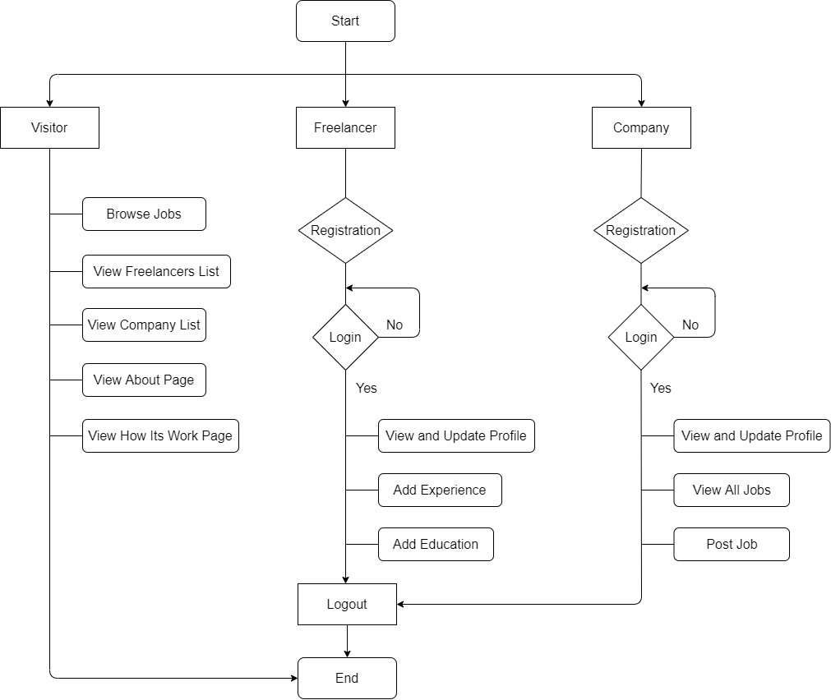
5. System Flowchart

Slide 8
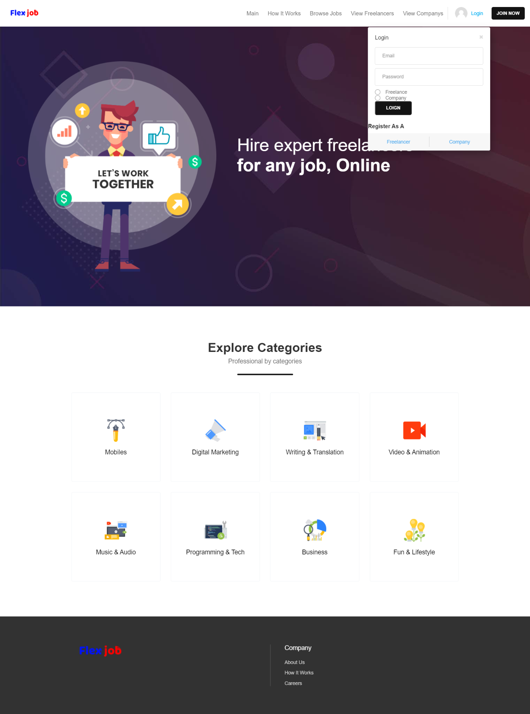
6. Implementation Screenshots
Login

Slide 9
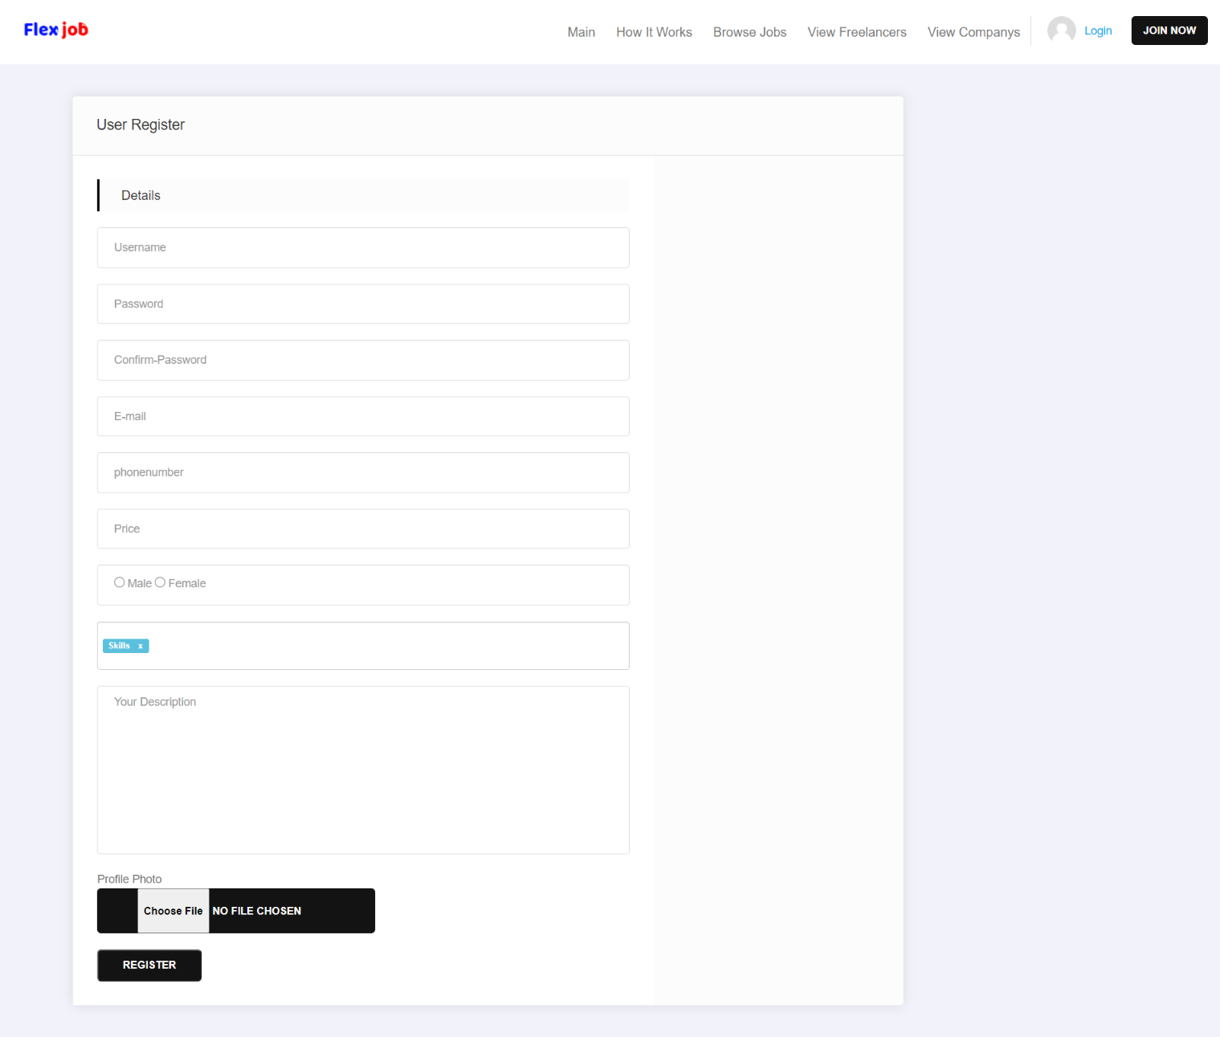
User Registration

Slide 10
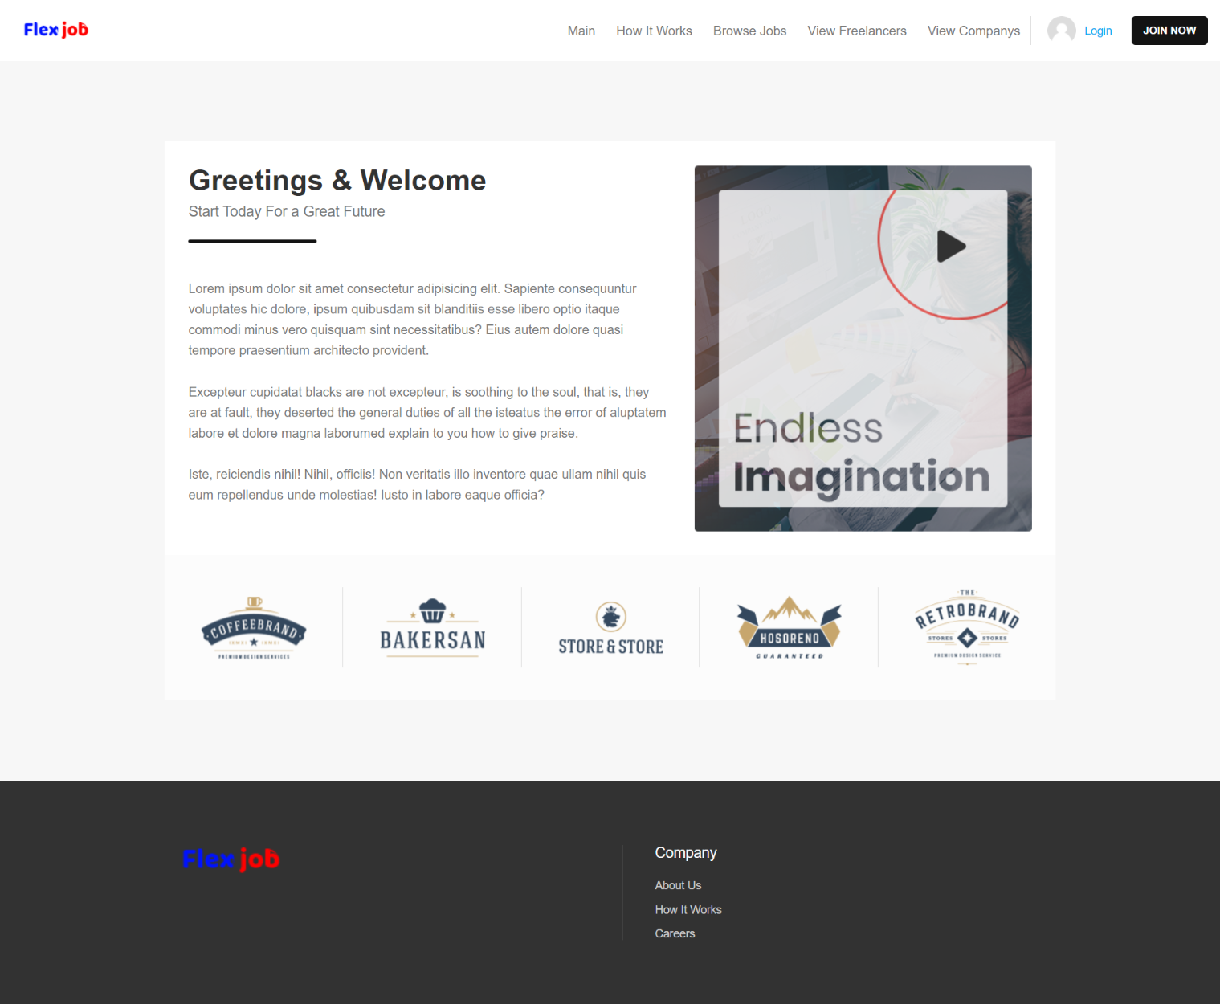
About us

Slide 11
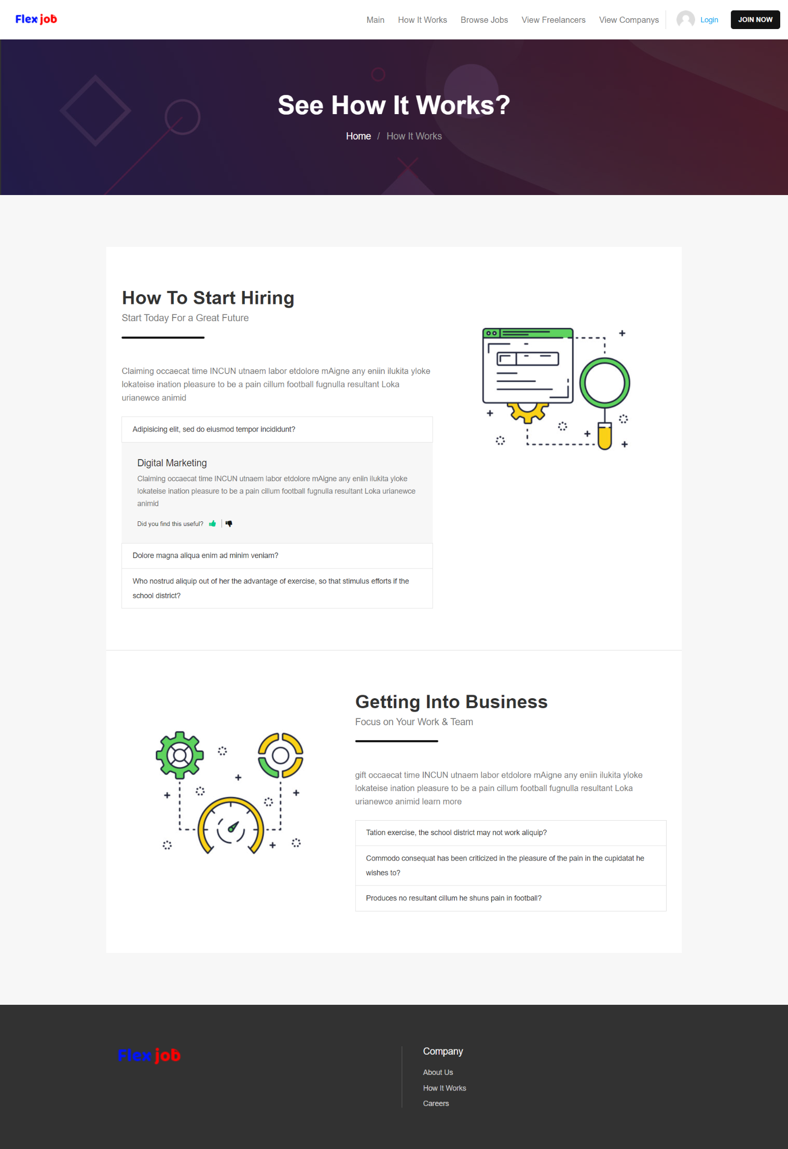
How it works

Slide 12
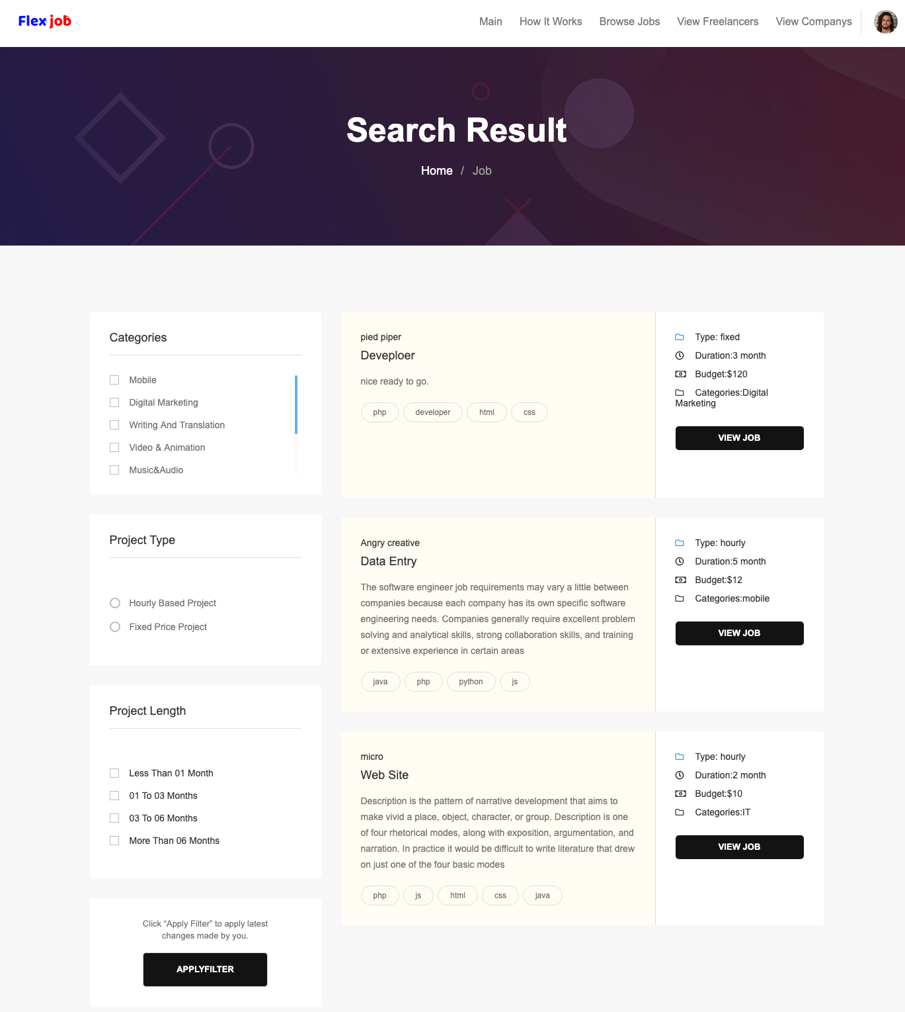
Job lists

Slide 13
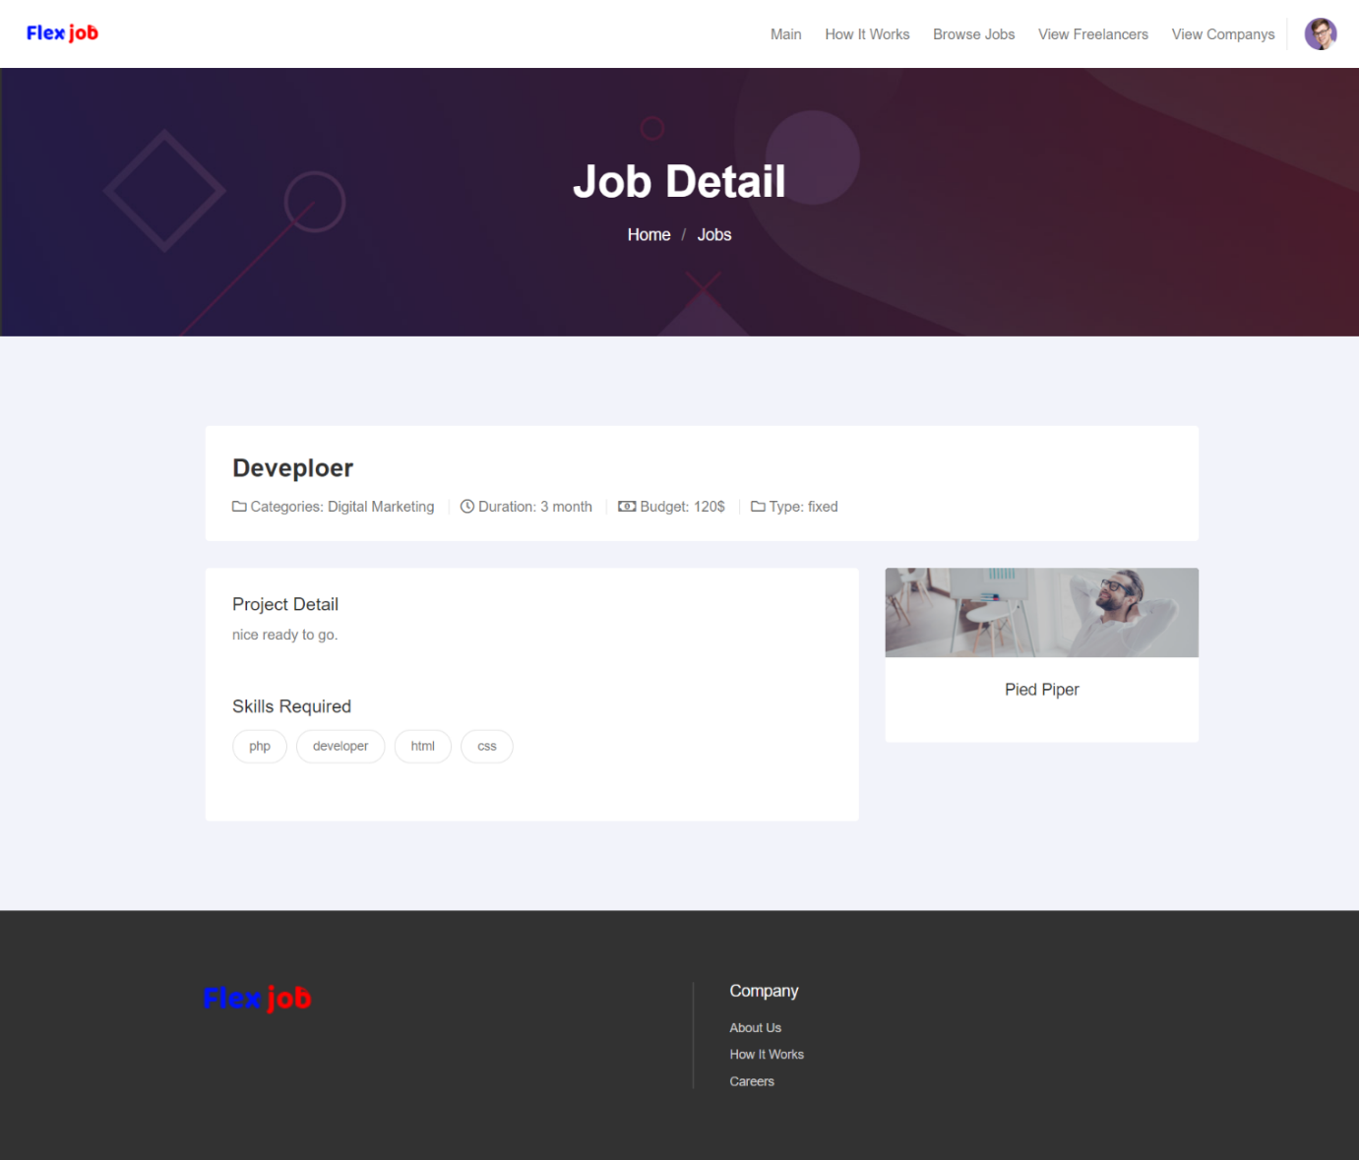
Job Detail

Slide 14
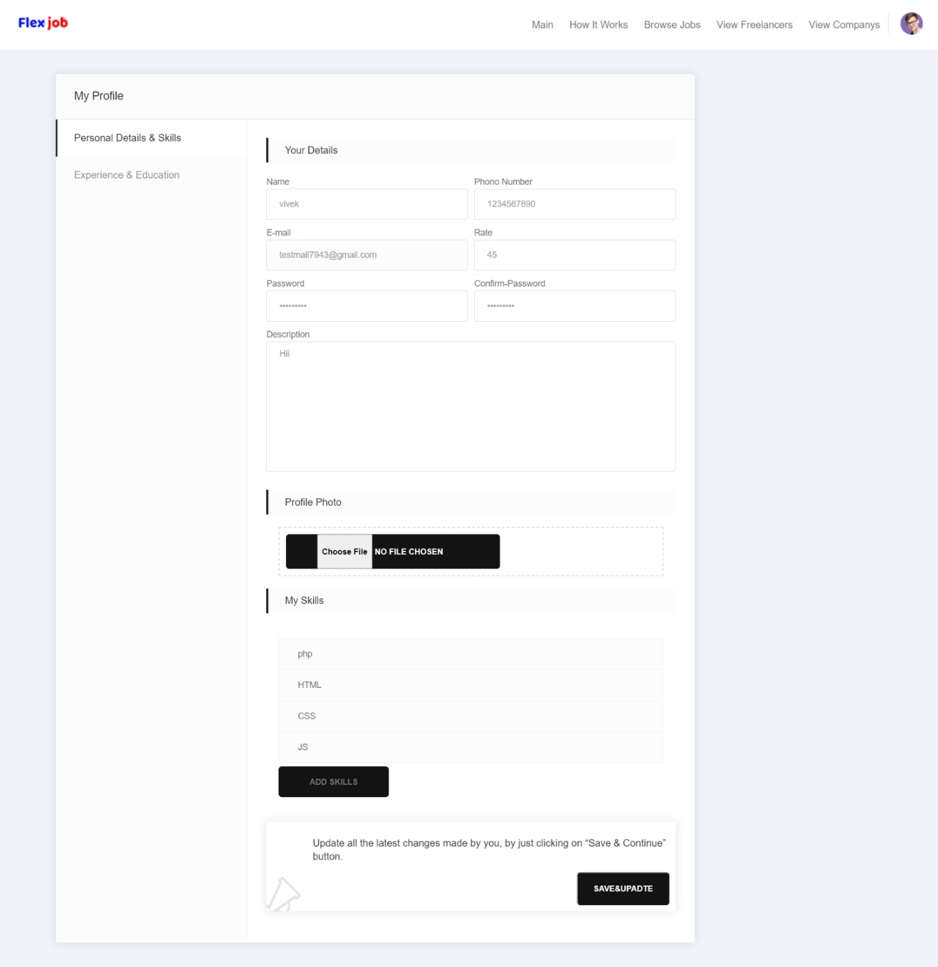
Freelancer Profile Setting

Slide 15
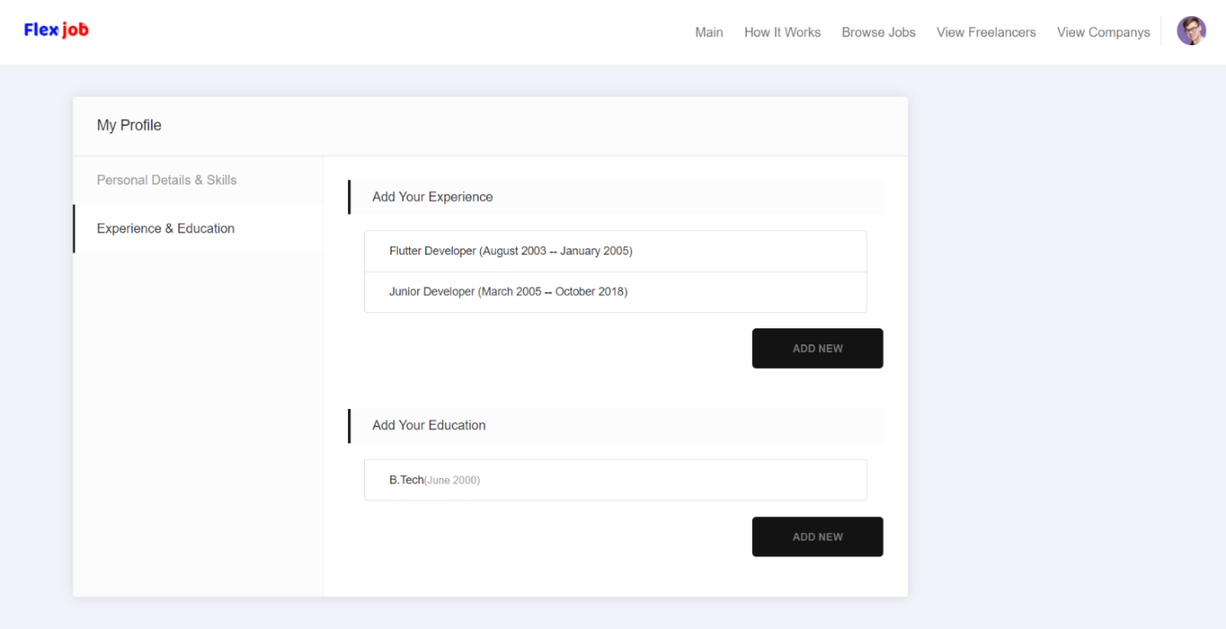
Education and Experience

Slide 16

Freelancers List

Slide 17
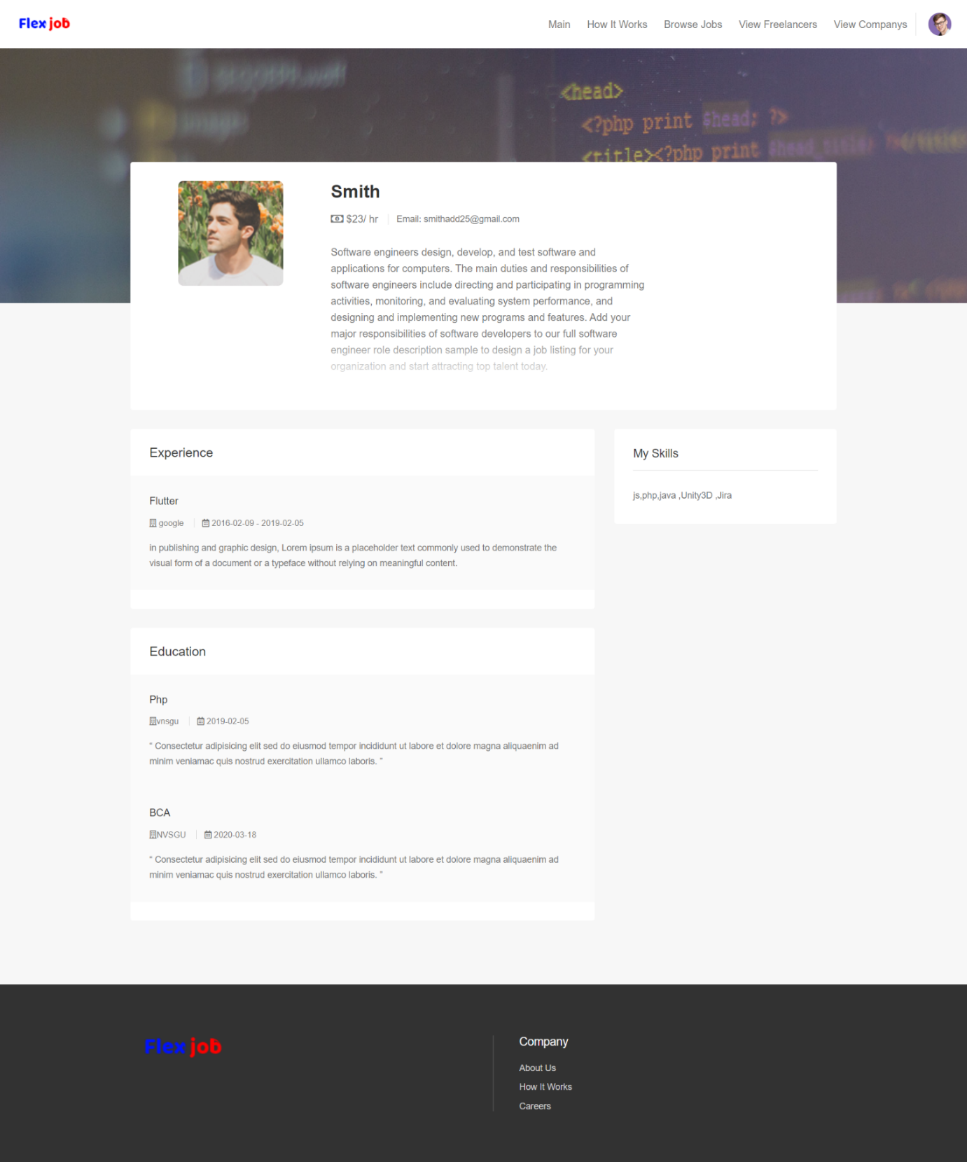
Freelancers Profile

Slide 18
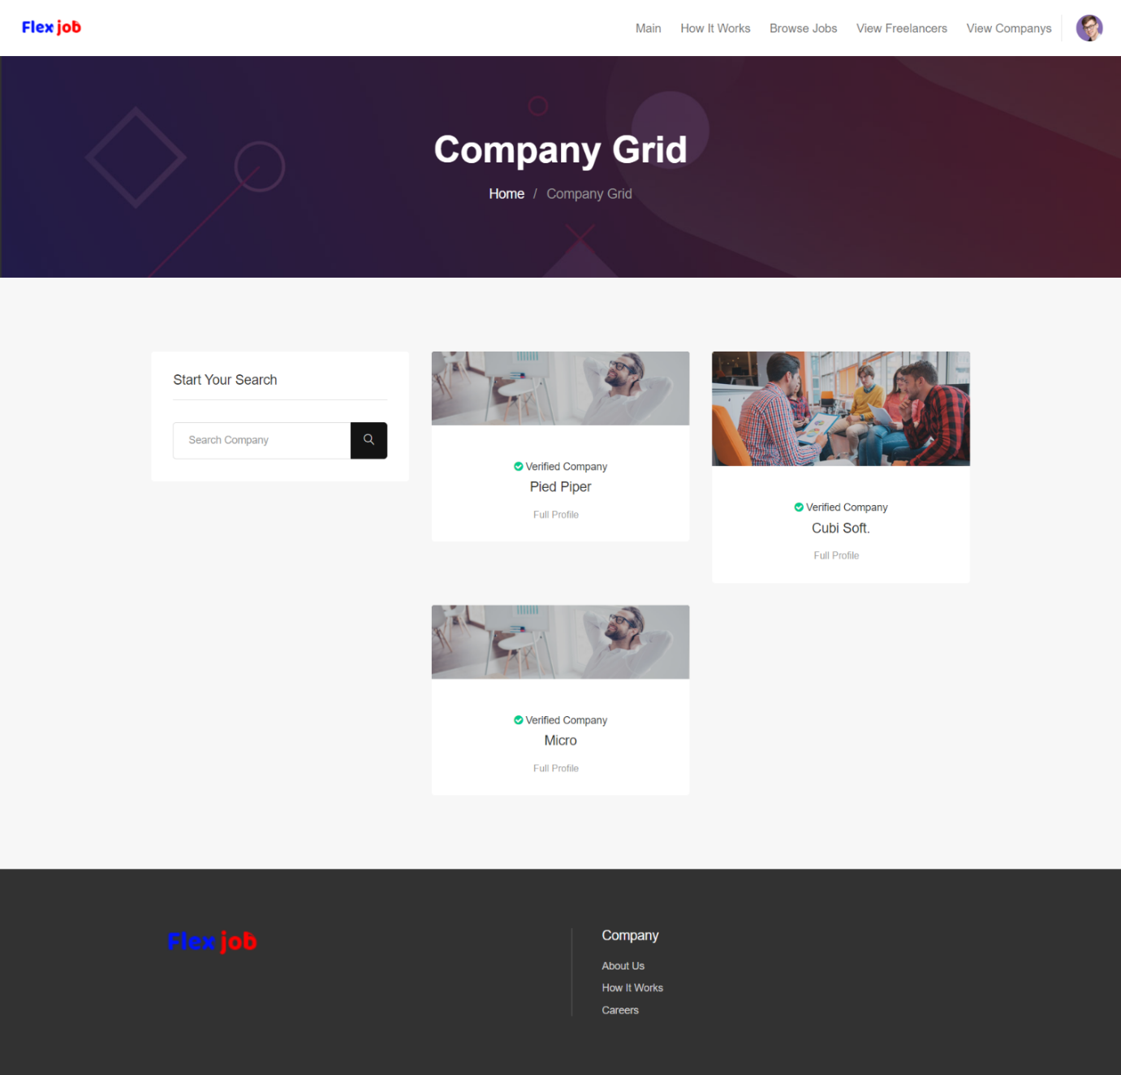
Company Grid

Slide 19
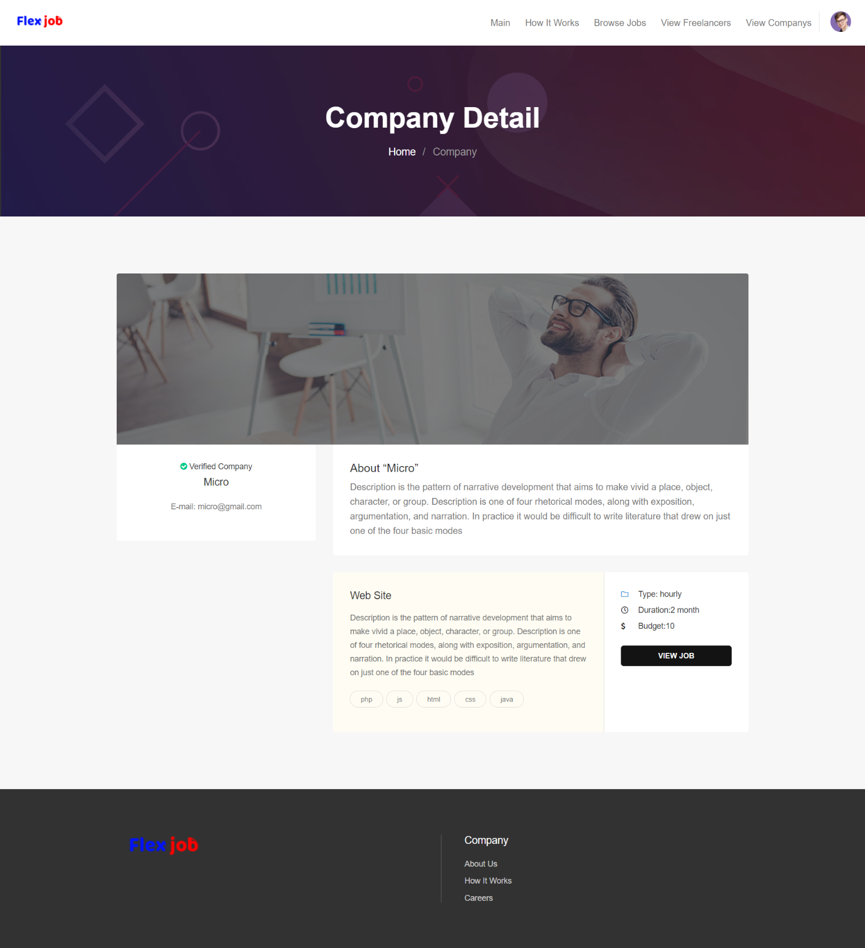
Company Details

Slide 20
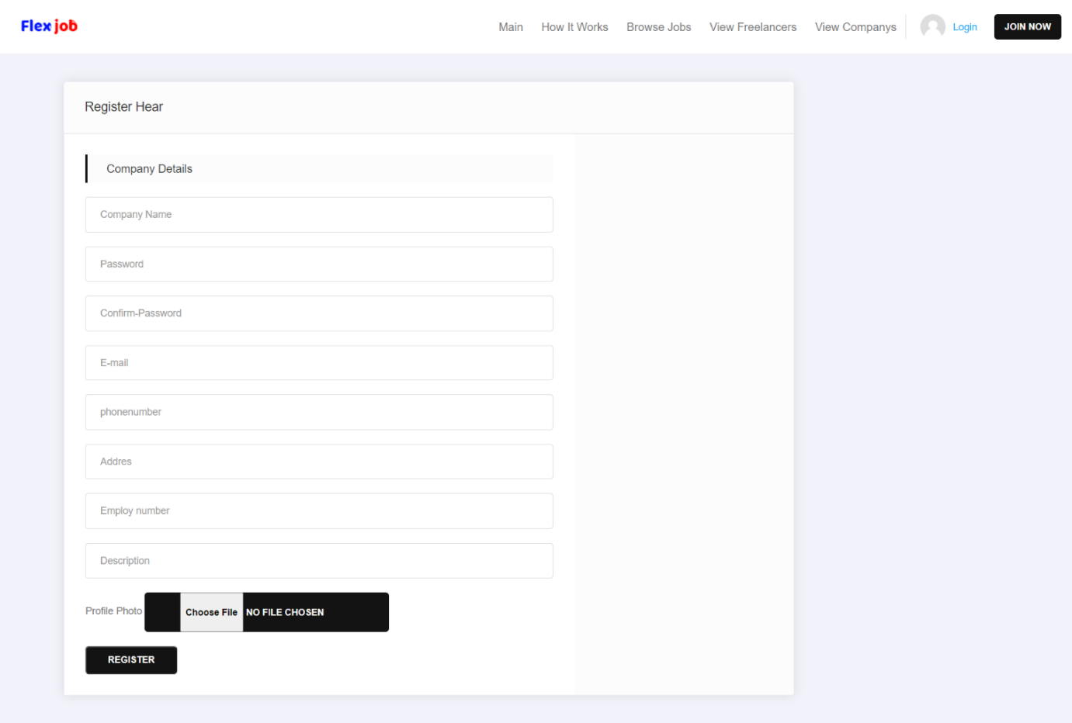
Company Registration

Slide 21
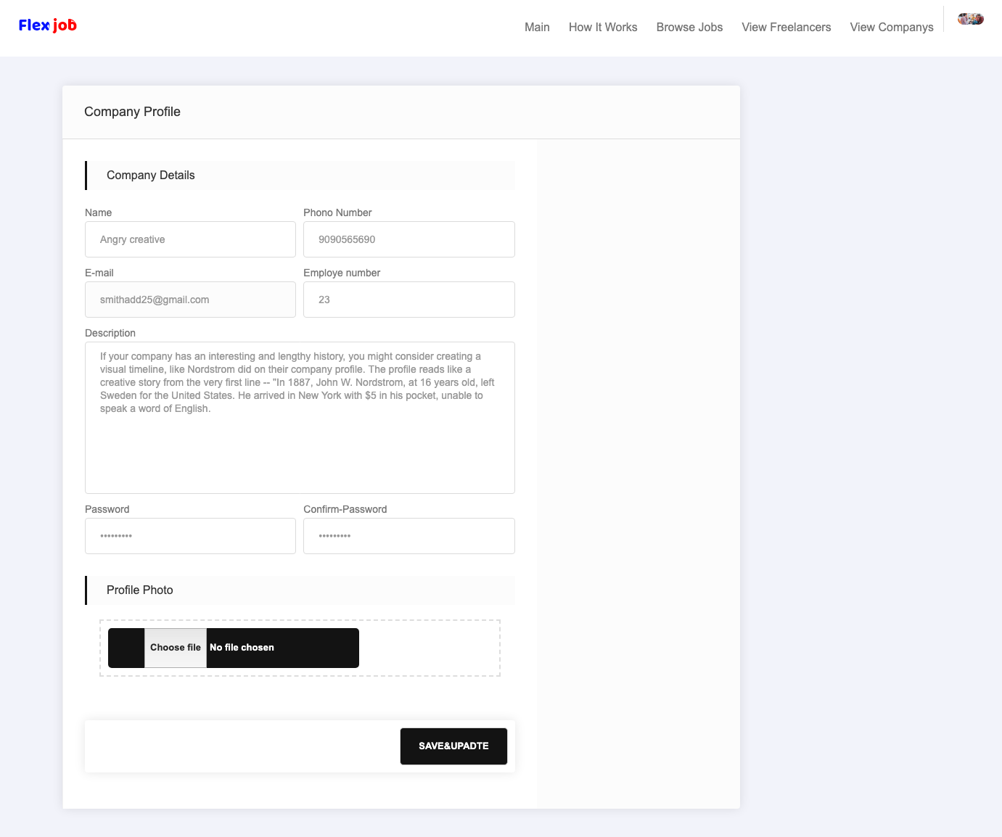
Company
Profile setting

Slide 22
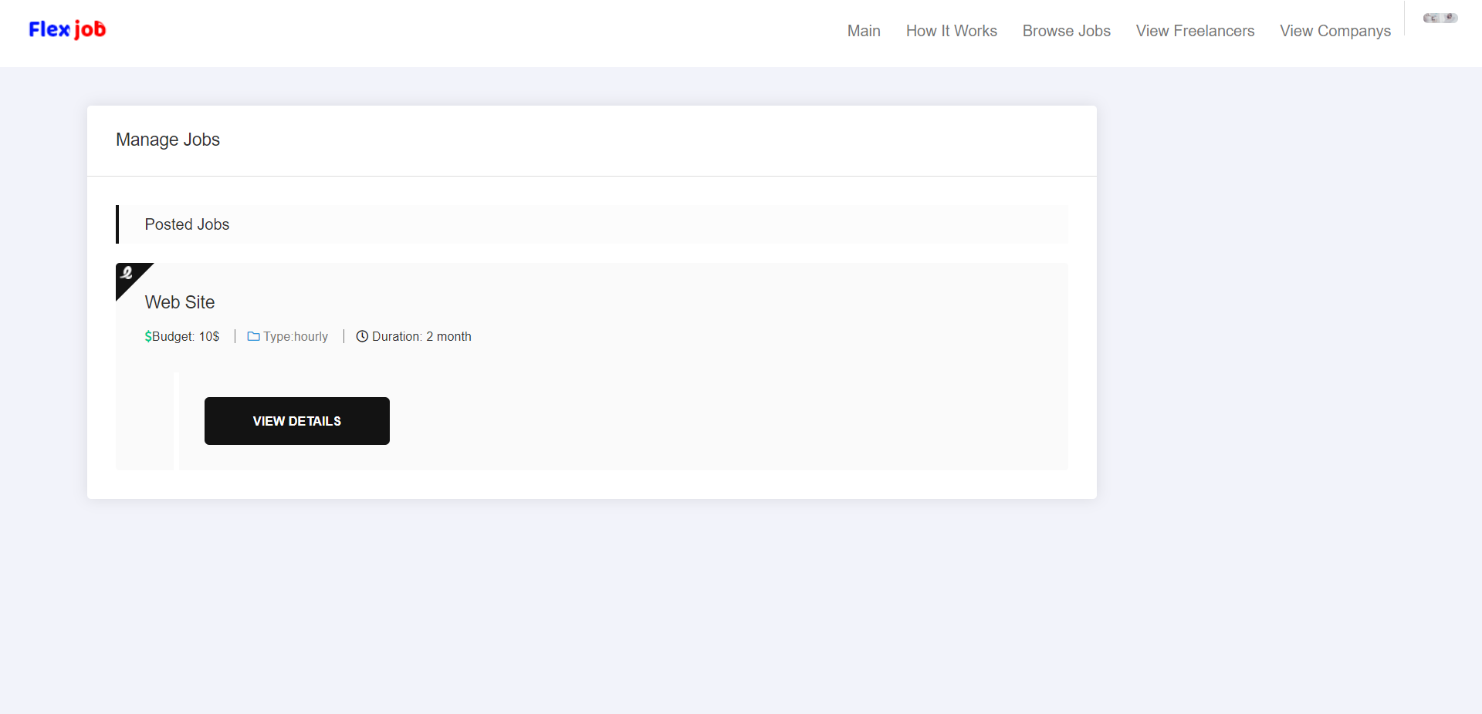
Manage Jobs

Slide 23
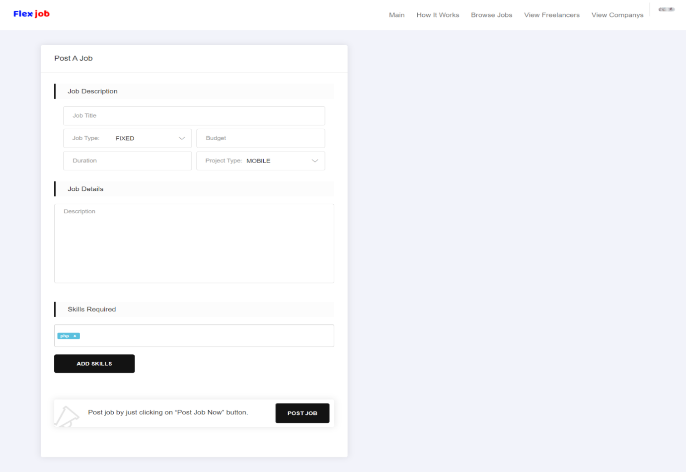
Post Job

Slide 24
7. Limitations of the Project
Online chatting did not provide between user and company.
No payment transaction between user and company.
User could not upload their resume in profile.

Slide 25
8. Project Outcomes
The scope of the website FlexJob is global or should be able to be accessed from anywhere through internet. Company or Freelancer can access website anywhere any time when they want.
We hope this type of FlexJob will yield to certain benefits to customer. We have tried our best to illustrate some of them.
The side must be user friendly and graphics must be used to give a striking look and feel of any services of item. The side must be easy and flexible to use.
Navigate must be smoother and user must be able to understand the links.

Slide 26
9. Future Enhancements
Adds up more searching features.
A chat system will develop in future.
Another add on future supports that is useful in making site better.
User and company will show their completed and ongoing jobs information.
Payment option will add in future.

Slide 27
10. Conclusion
From the reviews above we came into conclusion that an online job website may be used to incorporate all the technologies and trends in freelancing process. There are also more challenges in developing online job websites.

Slide 28
11. References
https://www.youtube.com/watch?v=JJSoEo8JSnc&list=PLillGF-RfqbZTASqIqdvm1R5mLrQq79CU&index=5&ab_channel=TraversyMedia
https://www.w3schools.com/js/default.asp
https://getbootstrap.com/docs/
https://www.w3schools.com/php/default.asp
https://www.youtube.com/playlist?list=PLoYCgNOIyGAB_8_iq1cL8MVeun7cB6eNc
https://www.w3schools.com/css/default.asp
https://www.youtube.com/watch?v=_al2bECumKg&ab_channel=CodeWithHarry
https://www.w3schools.com/bootstrap4/default.asp

Slide 29
12. Git-hub Links of the project
https://github.com/Mayank-393/flexjob
https://github.com/vivekmg/FlexJob
https://github.com/JayPandya1161/Flex-Job-website

Slide 30
Thank You

